Slide 1
Capstone Project 2
Social Network Outreach Analysis
For College Tennis Alumni Network
Springboard Data Science Career Track
Eric Cruz

Slide 2
Introduction
Problem Statement
The Intercollegiate Tennis Association (ITA) is the governing body of college tennis, overseeing men's and women's varsity tennis at all levels - NCAA Divisions I, II and III, NAIA and Junior/Community College. The College Tennis Alumni Network (CTAN) was formed under the ITA, and already has chapters in several American cities as well as Australia. Each chapter is a volunteer-led group helping former college tennis players in the area connect through events and other resources. The problem statement is to develop a resource which can be shared by all existing chapters and potential new chapters, as a tool for conducting an outreach campaign. That resource is a procedure for gathering information from college website rosters and letter winner lists, conducting a LinkedIn search by name and school, producing a report which predicts the accuracy of the search results, and providing it along with the resulting data. The report will be provided to volunteers who can use it to contact Alumni from their school.
Dataset
The deliverable datasets are the set of downloads for a College Tennis Team’s historical rosters from the school’s website, matched with a search for the roster name/school combination on LinkedIn. The roster download is obtained using a web scraping tool called Octoparse, which has a free version that is adequate for obtaining rosters from the scope of nearly 200 teams in the original New York outreach campaign. This represents nearly 100 schools, for both a Men’s and Women’s team. The LinkedIn search is obtained using Selenium WebDriver with ChromeDriver, and writing a Python script in a Jupyter Notebook.
Clients
The clients are the volunteers who will be provided with the data and report, and other interested parties such as coaches and college program supporters. To develop a preliminary set of target clients, a CTAN employee provided me with the list of existing members with a New York State home address, with the specific intention of asking for volunteers to form the New York chapter and offering to provide them with the data and report for their school. There are 142 members, approximately evenly split between Men and Women, representing 88 different schools. In general, most colleges have online rosters going back to the mid 2000’s, with some going back much further. Most websites also have a document available for download, which has a list of All-time letter winners.
Approach
The approach was to start with manually obtained LinkedIn search results that were used in an outreach campaign for the 50th Anniversary of Cornell Women’s Tennis event. This was used as the labelled data for building a binary classification model. This model is used to make predictions on whether the search result, if found, is the correct person.
The predictions are provided to the clients along with the collected data, in order help them prioritize which search results can be ignored, and which should be double checked.
The Random Forest Classifier model was selected after comparing results against a Logistic Regression and KNeighbors Classifier.

Slide 3
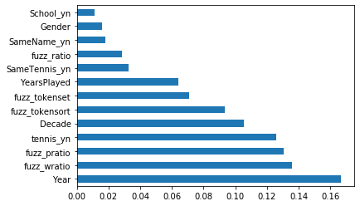
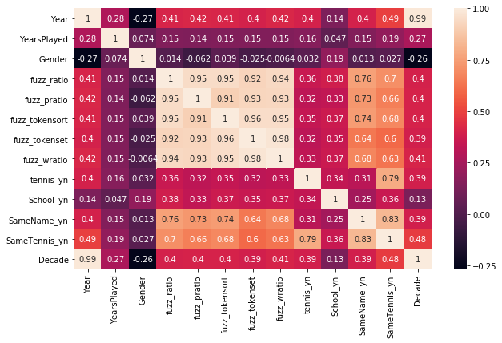
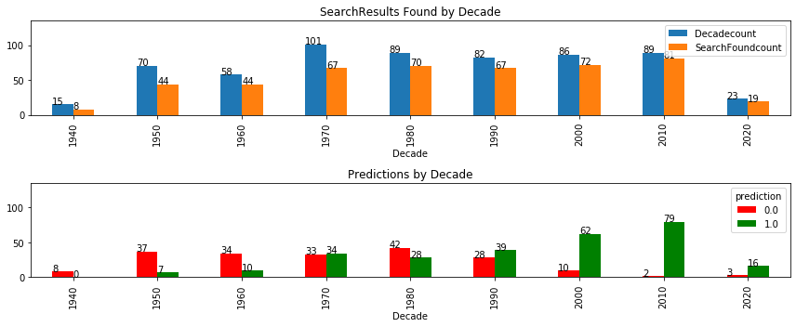
EDA, Feature Selection, Model Pipeline
A proxy for graduation year is the strongest predictor of whether a good profile can be found. Recent graduates are more likely to be on LinkedIn and likelihood decreases with age.
Selected text fields were converted to boolean integers to indicate whether the person identifies tennis and their school on LinkedIn
Fuzzy Wuzzy ratios were used to score text matching on the search name and result found, in addition to a boolean for an exact match on the name
Additional features were created as a function of the above.

Slide 4
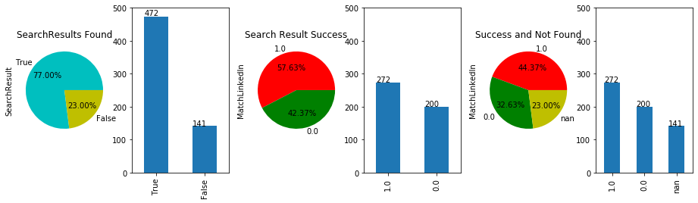
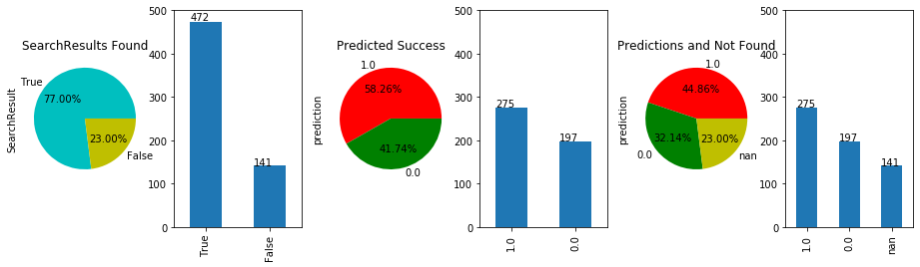
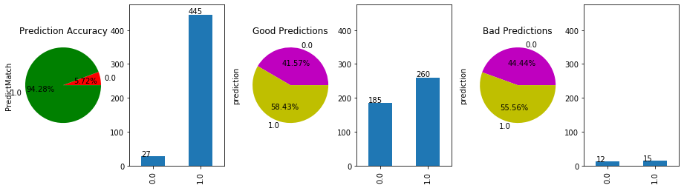
Search Results and Prediction Accuracy
The number of LinkedIn profiles found is 472 out of 613 or 77.0%
The number of Matches for profiles found is 272 out of 472 or 57.63%
The overall ratio of Matching profiles is 272 out of 613 or 44.37%
Predicted Results on the full dataset trained on 25% of the data
The number of LinkedIn profiles found is 472 out of 613 or 77.0%
The number of Predicted Matches for profiles found is 275 out of 472 or 57.63%
The number of Predicted Matching profiles is 275 out of 613 or 44.86%
The number of Right Predictions is 445 out of 472 or 94.28%
The number of Right Good Match Predictions is 260 out of 275 or 94.55%
The number of Right NoMatch Predictions is 185 out of 197 or 93.91%
The number of Wrong Good Match Predictions is 15 out of 275 or 5.45% These are FALSE POSITIVES, or Wrong Profile is predicted as Right, and you could contact the wrong person
The number of Wrong NoMatch Predictions is 12 out of 197 or 6.09% These are FALSE NEGATIVES, or Right Profile is predicted as Wrong, so you could miss out on contacting some people

Slide 5
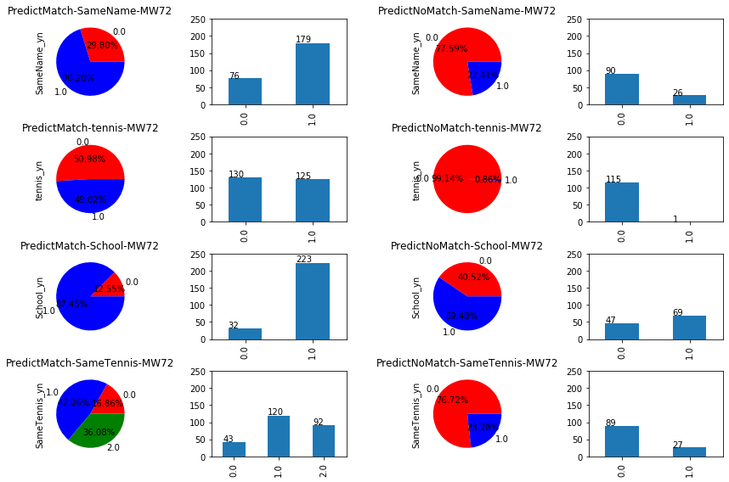
Boolean Feature Breakdown

Slide 6
Conclusion
The project summary describes the data for one school, with prediction results that are very accurate. It can sound a little misleading to tout the accuracy of mimicking a result with a true “success” rate of about 45%. Rather than summarize the model performance with statistical measures, it is best to describe how the search results, model predictions, and dataset are useful beyond the numbers. The profile search is highly successful for the younger generation, but returns a lot of wrong profiles for older generations. The model is useful in combination with the full dataset because the user can quickly filter out most of the profiles that are not worth reviewing. At the same time, the full roster list is provided with some information that is useful for performing a regular internet search in order to track down people who are not on LinkedIn. For example, using home town or the school’s town can turn up a person’s former address and possibly link it to a current address. Since the fuzz ratios and boolean are provided, the user can sort or filter out the obvious conditions for detecting false negatives. For example, check all the NoMatch predictions with a number filter on fuzz ratio “>80” to review profiles with a near matching name, since the model needs to guess that some of these are not matching in order to approximate the true frequency.

